Slide 1

Languageocity
A language learning app

Slide 2
TEAM NAME - CODERS ON RENT
Team Members
Eshan Gupta -: I am a 2nd year student studying at VIT Vellore and my interests include night coding and Cricket.
Skills-: Flutter App Developer || Web Developer || C || C++ || Python || Java
ReachOut-: https://linktr.ee/eshan1925
Rithesh Kunchakuri -: 2nd year student studying at VIT Vellore and an excited soul trying to learn and grow from the communities.
Skills-: Figma, Photoshop, Python, C++, Django.
ReachOut-: https://linktr.ee/rithesh_6

Slide 3

PROJECT IDEA
Languageocity is an application for everyone who wants to learn a different language and expand their reach. This particular application has been designed by having in mind that the user has the maximum interest in learning the language and cult for learning the language. The UI of the design is made basic for easier use. The main idea behind this app was to remove the barrier between people and the languages, majorly for the ones who migrate from one one place to other.The app has simple applications which make the learning easy and simple.

Slide 4

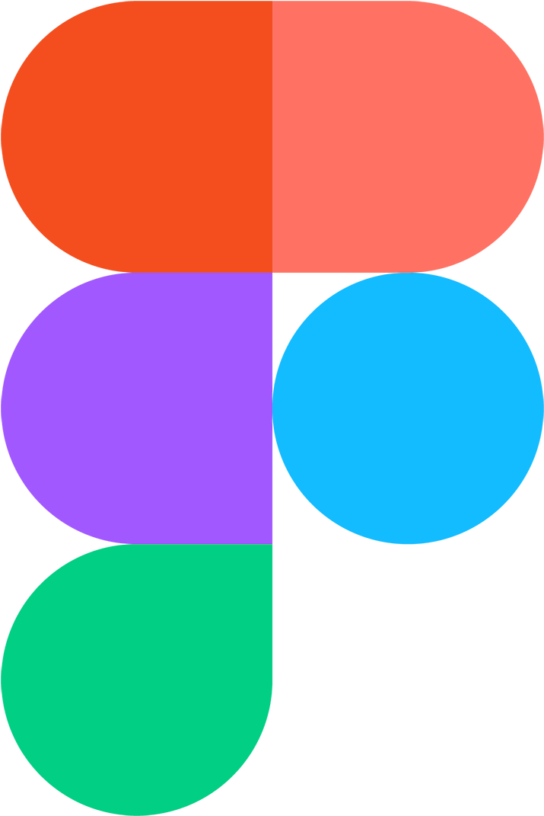


TECHNOLOGIES AND TECH STACKS USED
This particular app has been built using Flutter Framework and the coding part is done in Dart Language.
Flutter is the Software Development Kit that is used for making the cross-platform apps and Dart is the programming language that is used to code these apps, in simple words Flutter is just like the tools that we use for the construction of the house and the material which we use can be compared to Dart.
Figma is one of the most used platform to design any User interface currently and we have used figma to design the app
With this we have also used Google Firebase as the backend part i.e. for storing the user’s data.

Slide 5

IMPLEMENTATION
We have implemented our project by optimizing the code and the design for this project to make the User experience better. Right now this application is just at the prototype stage and not at its best but the vision and idea we have for this app is clear with the prototype itself. The implementation of all the features and everything is done in such a way that there is no difficulty while learning on the app.

Slide 6
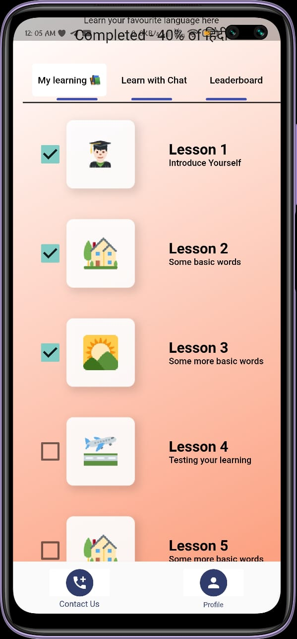
USES OF THE APP
Any person can learn any language from this application easily.
The application also has the feature to track the current progress and the number of lessons completed etc.
User also can see the badges and coins (reference to coins has been explained on the slide 9)earned and what are the milestones set to master the language.

Slide 7
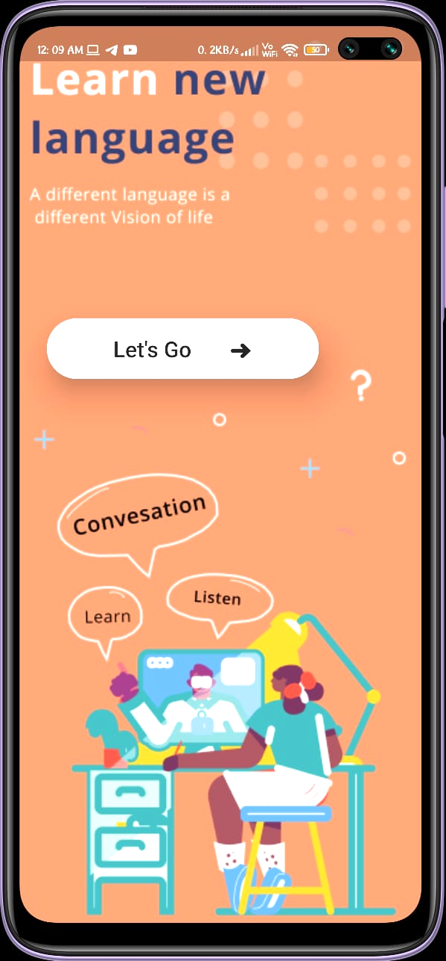
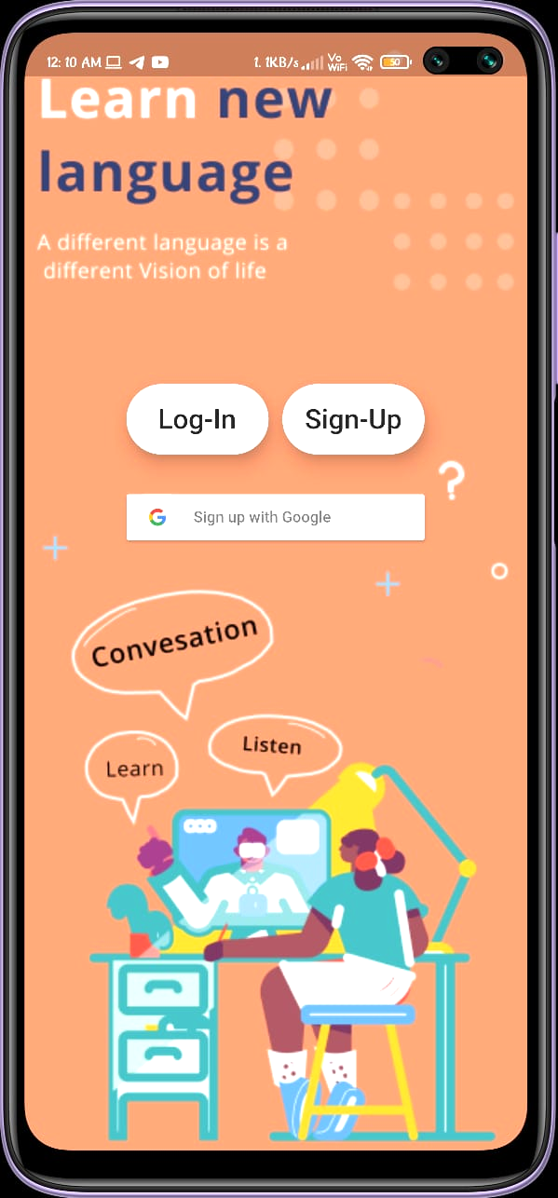
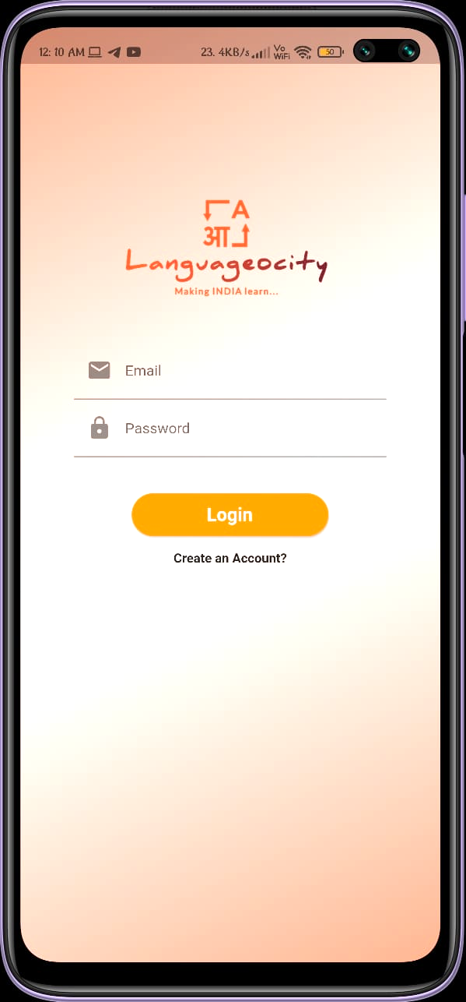
A Glimpse of the App
Startup Screen
Login/SignUp Screen
Login Screen

Slide 8
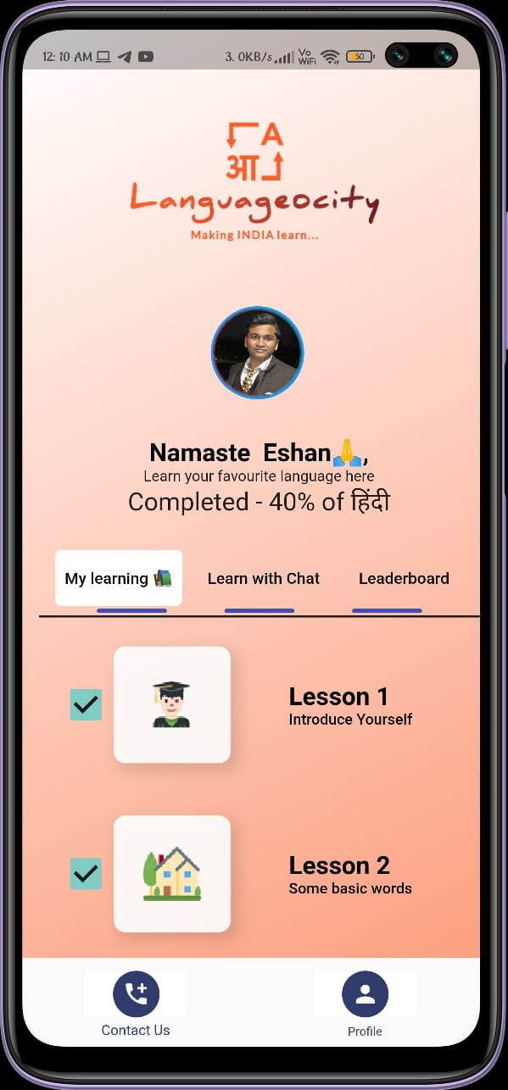
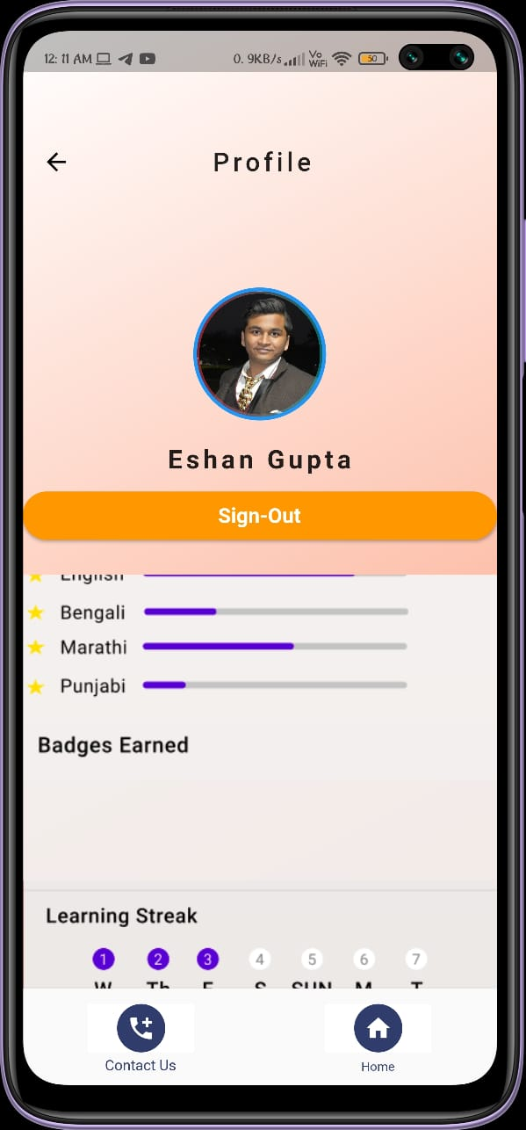
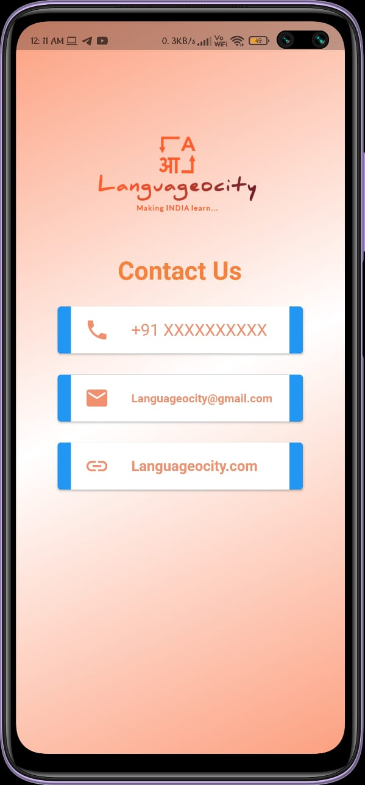
A Glimpse of the App
Main Screen
User Profile
Contact us

Slide 9
FUTURE ASPECTS OF THE APP
Due to limited resources we had in the Hackathon we were not able to implement all the features in the app that we could have, although we were able to achieve the target of producing a working prototype of the app before the end of the hackathon, the features that were left to be implemented are kept as the future aspects of the app and they are listed below :
1. Linking the app to the API so that user get the feature of questions and there will be no need of adding all the questions to the app’s database. I.e. all the questions will be sent by an Api.
2. The main and big feature for attraction of the customers and sponsors of the app (explained in detailed in slide 12) is that we will be giving our users coins for each challenge they complete. The coins can be redeemed in exchange for various items in the coin store.
3…...

Slide 10

.... Continued
3. We also have an idea of direct implementation of the google translator tool for quick translations so that any user if migrated from one place to another,during the learning stages of the language can conveniently use a translator tool for the conversation.
4. We also expect some sponsors for the application as we will promote and advertise them in the app. And we will be making balance between the sponsor and users through the reward store.

Slide 11
Our process is easy
Build
Test
ReBuild

Slide 12
CUSTOMER ATTRACTION
Now there are few more apps available in the market which provide the similar services, the main advantage of our app is that we are giving rewards to the customer for learning
So coins will be awarded to each user as he/she completes challenges or unlocks milestones etc. We also award the user one coin daily for just logging in and at least completing one chapter, this will motivate the user to come back to the app at least once daily and also he/she will be able to learn new language very easily due to consistency.
Many of the big platforms like Leetcode and Step Set Go follow this strategy of advertising and rewarding which are on trending now.
Now once the user has earned coins where can he/she spent it?

Slide 13

REWARD STORE
Once the user has earned some coins in the app he/she definitely would like to spend them, so here is where we bring in the concept of reward store.
Now the main question is what do we have in reward store. We definitely do not plan to open up the reward until and unless the application is able to generate any revenue or we find some sponsors as this app is fully free for the users who want to learn any new language.
Next question arises that why would anyone want to sponsor us and why do we need sponsors. So both questions have the same answer, we will advertise the sponsors on our application and in turn they will help us in providing valuable rewards/coupons in the reward store.
So that is how we would want our application to function. A a win-win situation where sponsors,creators and users get there desire complete.

Slide 14
In Simple Terms
Sponsors
Our App
Creators
Users

Slide 15
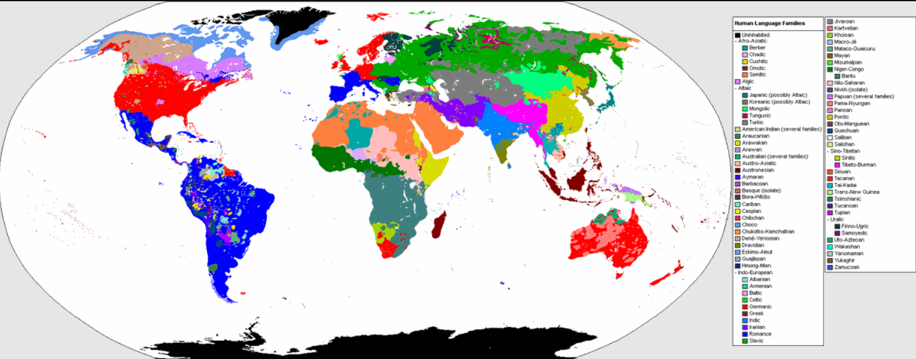
Languages spoken in the world
our office

Slide 16
6500
Whoa! That’s a big number, that’s the number of languages spoken in the world today.

Slide 17

CONCLUSIONS
Over and all we can say that this app if used properly by any user it will definitely benefit the user and the structure and design is also kept as easy as it can be.
We tried our best to implement all the features to the prototype of the application and tried our best to convey or idea through the app and this presentation.
At the end we really think that our idea has all the factors that is required for any application to come and survive in the market and the real world.
We really have dedicated our time and skills to the app and tried to produce the best result we could in front of you.
We hope for the best and overall this Hackathon truly was a wonderful experience for us.
Github Link-:
https://github.com/eshan1925/Language_Learner
Youtube Link-:
https://youtu.be/KsACwi_681s

Slide 18
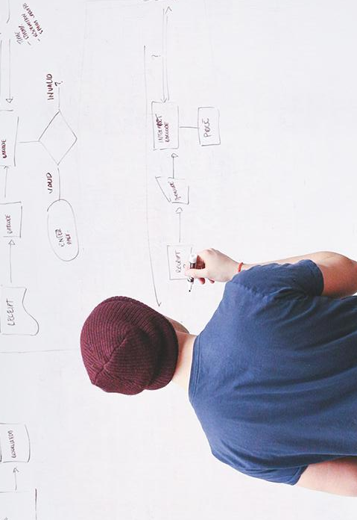
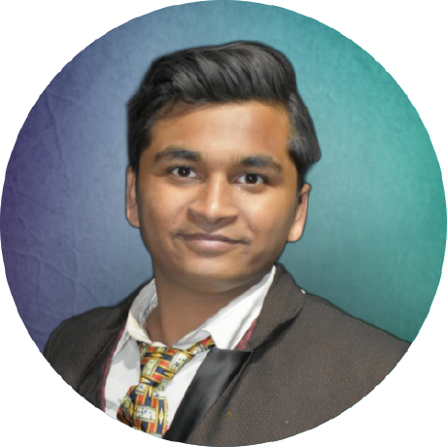
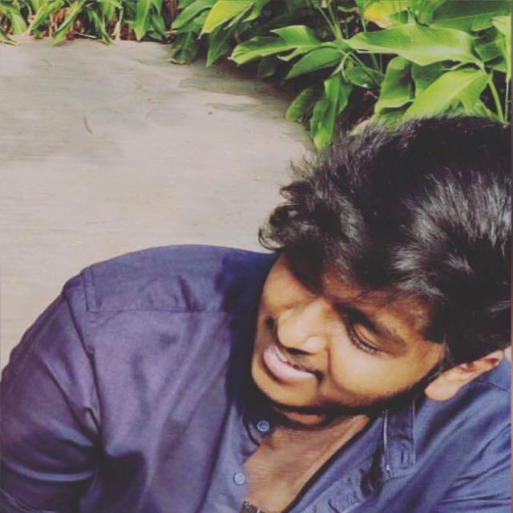
THANK YOU
Team Presentation
Eshan Gupta Student Developer
Rithesh kunchakuri
Student Designer
Open for questions !

